Slide 1

Data analysis topics
Luba Sheynin

Slide 2
Contents
Quantitative analysis; knowledge in descriptive statistics, probability, and statistical inference
Defining business metrics and processes
A/B testing
Machine learning

Slide 3
Descriptive statistics
Provides a way of capturing a given data set or sample.
There are two main types: centrality and variability measures.
Centrality
Arithmetic Mean Useful to characterize symmetric distributions without outliers
Geometric Mean Useful for averaging ratios. Always less than arithmetic mean
Median Exact middle value among a dataset. Useful for skewed distribution or data with outliers.
Mode Most frequent element in a dataset.
Variability
Standard Deviation Measures the square differences between the individual elements and the mean
Variance measures how far each number in the set is from the mean and thus from every other number in the set.
Interquartile Range. The IQR is a measure of variability, based on dividing a data set into quartiles. Quartiles divide a rank-ordered data set into four equal parts.

Slide 4
Descriptive statistics
Interpreting Variance
Variance can be explained away by attributing to sampling or measurement errors. Other times, the variance is due to the random fluctuations of the universe.
Correlation Analysis
Correlation coefficients r(X,Y) is a statistic that measures the degree that Y is a function of X and vice versa. Correlation values range from -1 to 1, where 1 means fully correlated, -1 means negatively-correlated, and 0 means no correlation.
Pearson Coefficient
Measures the degree of the relationship between linearly related variables
Spearman Rank Coefficient ( also Kendall )
Computed on ranks and depicts monotonic relationships
Note: Correlation does not imply causation!
Notes:
Correlation – A Practical Guide
https://algotrading101.com/learn/python-correlation-guide/

Slide 5

Defining metrics and processes
The 3 Keys to Success in SaaS:
Acquiring Customers
Retaining Customers
Monetizing Customers

Slide 6
Defining metrics and processes
SaaS Business Metrics
Conversions (Conversion Rate)
Monthly Recurring Revenue (MRR)
Customer Acquisition Cost (CAC)
Lifetime Value (LTV)
Notes:
Conversion Rate (shows the number of visits ended target action)= Total number of conversions / Total number of unique visitors * 100
MRR =avg revenue per customer / total # of customers that month (текущее или повторяющееся)
CAC= (Cost of sales + Cost of marketing)/new customers
LTV displays the profit that the company receives for the entire time of cooperation with the client= avg value of sale * number of transaction * retention time period

Slide 7
Defining metrics and processes
SaaS Product Metrics
Number of Active Users (daily, weekly, or monthly)
Net Promoter Score (NPS) (a type of customer satisfaction metrics)
Usage and Behavioral Metrics
Purchasing (frequency, number of purchased)
Retention (churn rate, renewal rate)
Notes:
NPS measure from a survey (choose from 1 to 10)
The churn rate formula is: (Lost Customers ÷ Total Customers at the Start of Time Period) x 100
Renewal rate = the number of customers who renew at the end of the specified time period ÷ the total number of customers who were up for renewal x 100

Slide 8
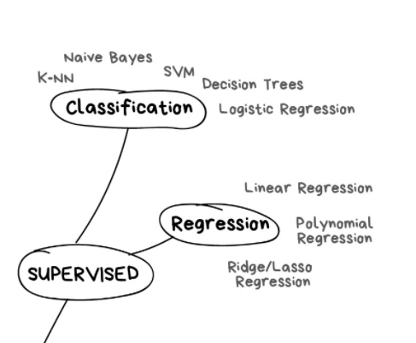
Part of the Machine Learning world map
Two problems arise repeatedly in data science.
Classification
Assigning something to a discrete set of possibilities, e.g., spam or non-spam, blood type (A, B, AB, O)
Regression
Predicting a numerical value, e.g., someone’s income, stock price

Slide 9
Basic modeling
dividing data into features (the X matrix of predictor variables) and a target variable (the outcome variable y)
splitting data into train and test sets
standardization of the feature matrix for the test set
train the model using two methods
check metrics for determining the accuracy of the models (accuracy, precision, recall)
train the final model
Notes:
Train/Test Split and Cross Validation – A Python Tutorial
https://algotrading101.com/learn/train-test-split/

Slide 10
Basic modeling
Logistic regression
Predictor variable – Continuous (float variables) (Quantitative variables)
Outcome variable – Binary (0/1) (Categorical variables)

Slide 11
A/B TESTING WORKFLOW
1. Choose one element to test: pick an element you feel will have an impact on the customer’s behavior.
1
2. Write a hypothesis
2
3. Decide on the sample group (Online test duration and sample size calculators)
3
4. Define what success will look like. Success can be measured in terms of opens, clicks, shares, conversions, and more.
4
5. Set up the test: schedule when you’ll administer the test and determine how long it will run
5
6. Look at test results: after the test has completed, analyze data sets and examine results
6
7. Determine the winning combination
7
8. Make necessary changes
8
Notes:
A/B testing is a common methodology to test new products or new features
The main principle of an A/B test is to split users into two groups; showing the existing product or feature to the control group and the new product or feature to the experiment group. Finally, evaluating how users respond differently in two groups and deciding which version is better.

Slide 12
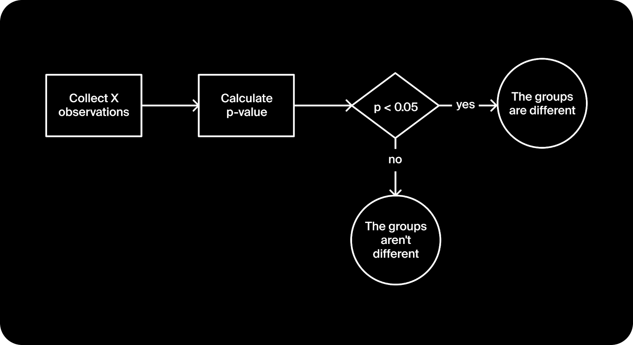
a/b testing procedure
The p-value is the probability of obtaining results at least as extreme as the observed results of a statistical hypothesis test, assuming that the null hypothesis is correct.
Notes:
the p-value is the probability of obtaining results at least as extreme as the observed results of a statistical hypothesis test, assuming that the null hypothesis is correct

Slide 13
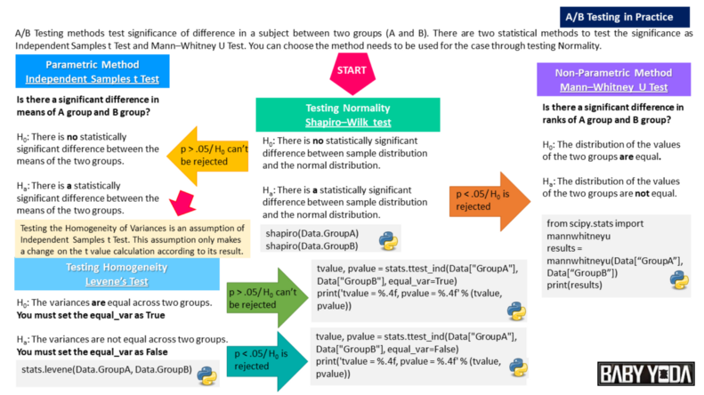
a/b testing. analysis of the result
Notes:
The significant level alpha is set equal to 0.05

Slide 14
a/b testing. Terms
A/A testing
Significance level (alpha)
A p-value is a measure of the probability that an observed difference could have occurred just by random chance.
Stability of Cumulative Metrics to avoid peeking problem
Notes:
Statistical significance is a determination that a relationship between two or more variables is caused by something other than chance.
Statistical significance is used to provide evidence concerning the plausibility of the null hypothesis, which hypothesizes that there is nothing more than random chance at work in the data.
Statistical hypothesis testing is used to determine whether the result of a data set is statistically significant.

Slide 15
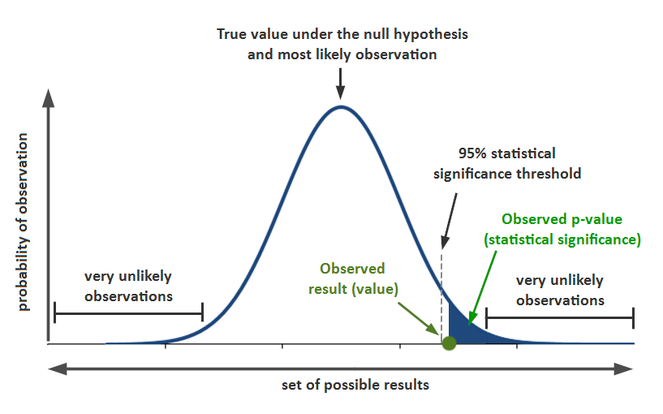
a/b testing. Terms
P-value
Notes:
A p-value is a measure of the probability that an observed difference could have occurred just by random chance. Graphically, the p value is the area in the tail of a probability distribution. In null hypothesis significance testing, the p-value is the probability of obtaining test results at least as extreme as the results actually observed, under the assumption that the null hypothesis is correct.

Slide 16
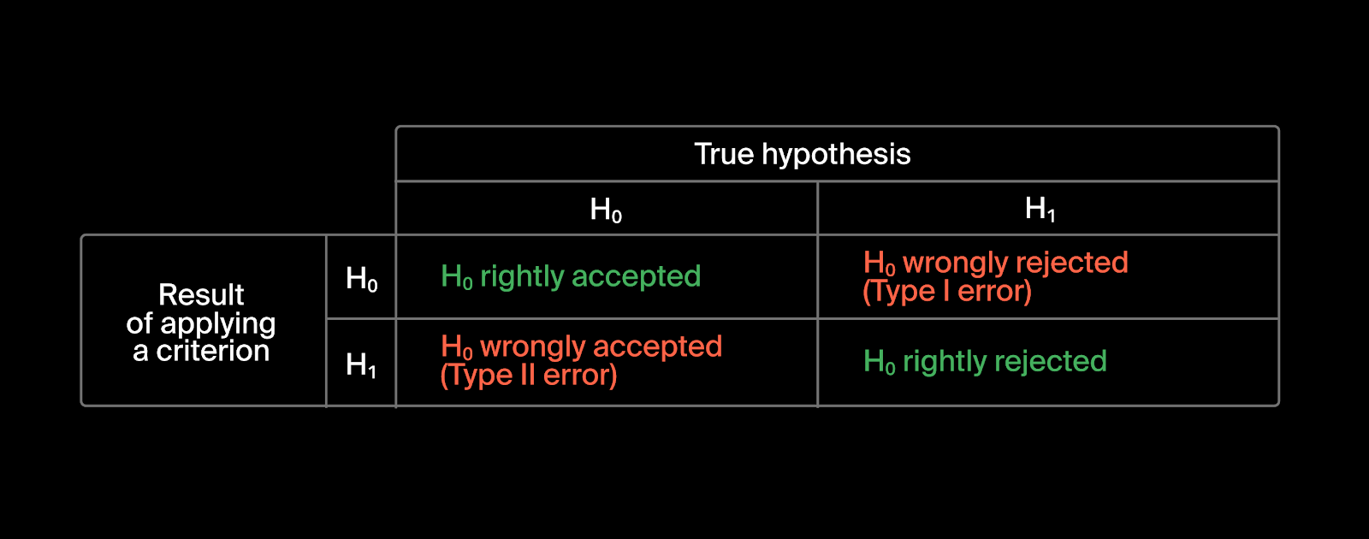
a/b testing. Type 1 and type II errors
There’s always a risk of making one of two decision errors when interpreting study results:
Type I error: rejecting the null hypothesis of no effect when it is actually true.
Type II error: not rejecting the null hypothesis of no effect when it is actually false.
Notes:
a Type I error is a false positive conclusion, while a Type II error is a false negative conclusion.
The risk of committing type I error is the significance level (alpha or α) you choose.
The risk of a Type II error is inversely related to the statistical power of a study. The higher the statistical power, the lower the probability of making a Type II error.
Power is usually set at 80%. This means that if there are true effects to be found in 100 different studies with 80% power, only 80 out of 100 statistical tests will actually detect them.

